Slide 1
SD: Patterns Ninject for DI
25-Apr-18 | Start
27-Apr-18 | 25
01-May-18 | 26
07 May 18 | 33
Appendix
Online

Slide 2
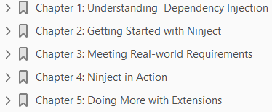
Ninject for DI
Ch | Date
1 | 27 Apr 18
2
3
4
5
Mastering Ninject for DI 09 2013

Slide 3
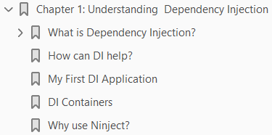
1
Understanding Dependency Injection

Slide 4
Intro
This chapter introduces the Dependency Injection (DI) concepts and describes the advantages of using this pattern.
We will also go through a simple example and implement the principles and patterns related to the DI technique to it.
After understanding what a DI container is, we will discuss why Ninject is a suitable one.
By the end of this chapter, the reader is expected to have a good understanding of DI and how Ninject can help them as a DI container.
The topics covered in this chapter are:
What is Dependency Injection?
How can DI help?
My first DI application
DI Containers
Why use Ninject?

Slide 5
What is Dependency Injection?
Dependency Injection is one of the techniques in software engineering which improves the maintainability of a software application by managing the dependent components.
In order to have a better understanding of this pattern, let's start this section with an example to clarify what is meant by a dependency, and what other elements are involved in this process.
Cameron is a skilled carpenter who spends most of his time creating wooden stuffs. Today, he is going to make a chair.
He needs a saw, a hammer, and other tools.
During the process of creating the chair, he needs to figure out what tool he needs and find it in his toolbox.
Although what he needs to focus on is how to make a chair, without thinking of what tools he needs and how to find them, it is not possible to finish the construction of the chair.
The Code 1-1 is the C# representation of Cameron, as a carpenter.
Sarah is a heart surgeon. She works for a hospital and spends her days in the operation room, and today she is going to perform an open-heart surgery.

Slide 6
What is Dependency Injection? |
It is a sophisticated procedure, and she needs to focus on the operation itself, rather than finding the tools during the operation.
That is why she has an assistant to provide her with the tools she requires.
This way, she ensures that the exact tool that she needs will be in her hand by her assistant.
She doesn't need to know where the tool is and how to find it. These are her assistant's responsibilities.
Code 1-2 is the C# implementation of Sarah, the surgeon.
As we can see, she doesn't need to worry about how to get the forceps; they are provided to her by someone else.
In the previous examples, Cameron and Sarah are samples of dependent components that have a responsibility, and tools that they need are their dependencies.
Dependency Injection is all about how they get to the tools they need.
In the first example, the dependent component (Cameron) itself had to locate the dependency, while in the second one, a third party (the assistant) locates and provides it.
This third party is called an Injector, which injects the dependencies.

Slide 7
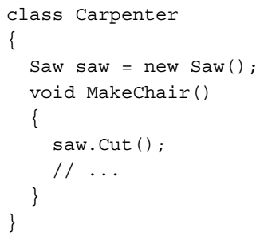
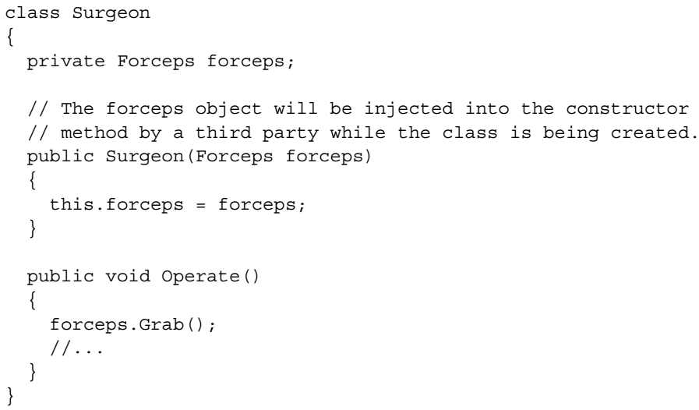
Code 1-1 || 1-2

Slide 8
DI or Inversion of Control (IoC)
Martin Fowler defines Inversion of Control (IoC) as a style of programming in which the framework takes the control of the flow instead of your code.
Comparing handling an event to calling a function is a good example to understand IoC.
When you call the functions of a framework, you are controlling the flow, because you decide in what sequence to call the functions.
But in case of handling events, you are defining the functions and the framework is calling them, so the control is inverted to the framework instead of you.
This example showed you how control can be inverted.
DI is a specific type of IoC, because instead of your components concern about their dependencies, they are provided with the dependencies by the framework.
Indeed, as Mark Seemann states in his book, Dependency Injection in .NET, IoC is a broader term which includes, but is not limited to, DI, even though they are often being used interchangeably.
IoC is also known as the Hollywood Principle: "Don't call us, we'll call you".

Slide 9
How can DI help?
Every software application is inevitable of change.
As your code grows and new requirements arrive, the importance of maintaining your codes becomes more tangible, and it is not possible for a software application to go on if it is not maintainable.
One of the design principles that lead to producing a maintainable code is known as Separation of Concerns (SoC).
The SoC is a broad concept and is not limited to software design; but in the case of composing software components, we can think of SoC as implementing distinct classes, each of which deals with a single responsibility.
In the first example, finding a tool is a different concern from doing the operation itself and separating these two concerns is one of the prerequisites for creating a maintainable code.
Separation of concerns, however, doesn't lead to a maintainable code if the sections that deal with concerns are tightly coupled to each other.
Although there are different types of forceps that Sarah may need during the operation, she doesn't need to mention the exact type of forceps which she requires.

Slide 10
How can DI help? |
She just states that she needs forceps, and it is on her assistant to determine which forceps satisfies her need the best.
If the exact type that Sarah needs is temporarily not available, the assistant has the freedom to provide her with another suitable type.
If the hospital has bought a new type of forceps that the assistant thinks is more suitable, he or she can easily switch to the new one because he or she knows that Sarah doesn't care about the type of forceps as long as it is suitable.
In other words, Sarah is not tightly coupled to a specific type of forceps.
The key principle leading to loose coupling is the following, from the Gang of Four (Erich Gamma, Richard Helm, Ralph Johnson, and John Vlissides, Design Patterns: Elements of Reusable Object-Oriented Software):
"Program to an "interface", not an "implementation“.”
When we address our dependencies as abstract elements (an interface or abstract class), rather than concrete classes, we will be able to easily replace the concrete classes without affecting the consumer component – Code 1-3.
The Surgeon class is addressing the interface IForceps and does not care about the exact type of the object injected into its constructer.

Slide 11

How can DI help? ||
The C# compiler ensures that the argument passed to the forceps parameter always implements the IForceps interface and therefore, existence of the Grab( ) method is guaranteed.
The following code shows how an instance of Surgeon can be created providing with a suitable forceps:
Because the Surgeon class is programmed to the IForceps interface rather than a certain type of forceps implementation, we can freely instantiate it with any type of forceps that the assistant object decides to provide.
As the previous example shows, loose coupling (surgeon is not dependent on a certain type of forceps) is a result of programming to interface (surgeon depends on IForceps) and SoC, (choosing forceps is the assistant's concern, while the surgeon has other concerns) which increases the code maintainability.
Now that we know loose coupling increases the flexibility and gives freedom of replacing the dependencies easily; let's see what else we get out of this freedom other than maintainability.

Slide 12
How can DI help? |||
One of the advantages of being able to replace the concrete classes is testability.
As long as the components are loosely coupled to their dependencies, we can replace the actual dependencies with Test Doubles such as mock objects.
Test Doubles are simplified version of the real objects that look and behave like them and facilitate testing.
The Code 1-4 shows how to unit test the Surgeon class using a mock forceps as a Test Double.
In this unit test, an instance of the Surgeon class is being created as a System Under Test (SUT), and the mock object is injected into its constructor.
After calling the Operate method on the surgeon object, we ask our mock framework to verify whether the Grab operation is called on the mock forceps object as expected.
Maintainability and testability are two advantages of loose coupling, which is in turn a product of Dependency Injection.
On the other hand, the way an Injector creates the instances of concrete types, can introduce the third benefit of DI, which is the late binding.
An Injector is given a type and is expected to return an object instance of that type.
It often uses reflection in order to activate objects.

Slide 13
How can DI help? ||||
So, the decision of which type to activate can be delayed to the runtime.
Late binding gives us the flexibility of replacing the dependencies without recompiling the application.
Another benefit of DI is extensibility.
Because classes depend on abstractions, we can easily extend their functionality by substituting the concrete dependencies.

Slide 14
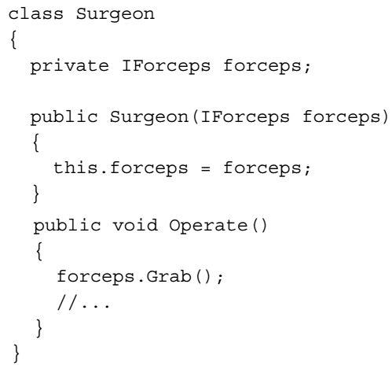
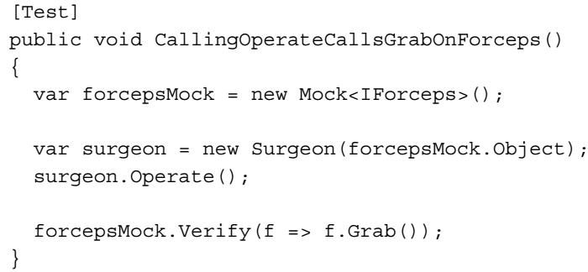
Code 1-3 || 1-4

Slide 15
My First DI Application
We start our example with a service class in which the concerns are not separated.
Then we will improve maintainability step-by-step, by first separating concerns and then programming to interface in order to make our modules loosely coupled.
At the final point, we will have our first DI application.
The main responsibility of this service is to send an e-mail using the information provided.
In order to make the example simple and clear, client initialization is omitted – Code 1-5.
Then, we add some logging to it, so that we know what is going on in our service – Code 1-6.
After a little while, we find it useful to add time to our logs.
In this example, sending the mail message and logging functionality are two different concerns which are addressed in a single class, and it is not possible to change the logging mechanism without touching the MailService class.
Therefore, in order to add time to our logs, we have to change the MailService class.
So, let's re-factor this class and separate the concern of logging from sending a mail prior to adding the time functionality: Code 1-7.

Slide 16
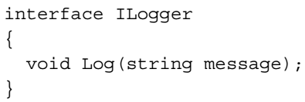
My First DI Application |
The ConsoleLogger class is only responsible for the logging mechanism, and this concern is removed from MailService.
Now, it is possible to modify the logging mechanism without affecting MailService – Code 1-8.
Now, we need to write our logs in Windows Event Log rather than showing them in console.
Looks like we need an EventLogger class as well – Code 1-9.
Although the concern of sending mail and logging are now separated in two different classes, MailService is still tightly coupled to the ConsoleLogger class, and it is not possible to replace its logger without modifying it.
We are just one step away from breaking the tight coupling between the MailService and Logger classes.
We should now introduce the dependencies as interfaces rather than concrete classes:

Slide 17
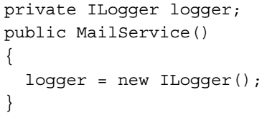
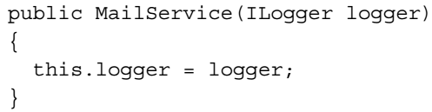
My First DI Application ||
Both the ConsoleLogger and EventLogger classes should implement this interface – Code 1-10.
Now, it is time to remove the references to the concrete ConsoleLogger class and address ILogger instead:
But the previous code won't compile because it doesn't make sense to instantiate an interface.
We should introduce this dependency as a constructor parameter and have the concrete object injected into it by a third party:
At this point, our classes are loosely coupled and we can change the loggers freely without affecting the MailService class.

Slide 18
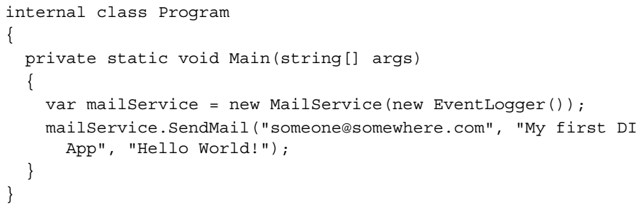
My First DI Application |||
Using DI, we have also separated the concern of creating a new instance of the logger class, which includes the concern of deciding what concrete logger to use from the main responsibility of MailService, which is sending an e-mail:
The main method of this application is where we decide what concrete objects to inject in our dependent classes.
This (preferably) unique location in the application where modules are composed together is named Composition Root by Mark Seemann.
For more information on DI, Dependency Injection in .NET, by Mark Seemann is recommended.

Slide 19
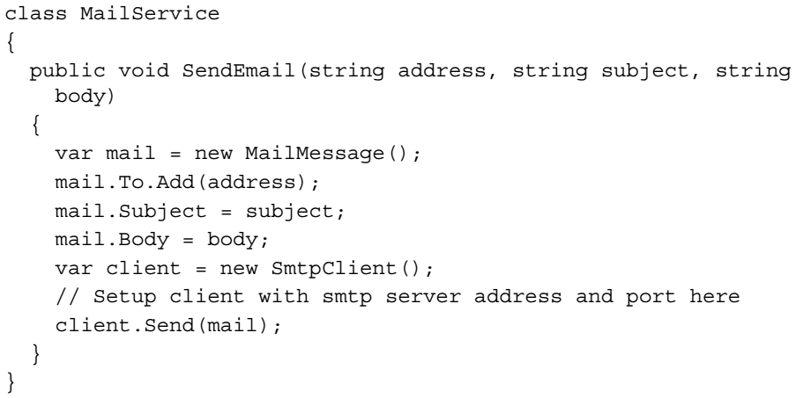
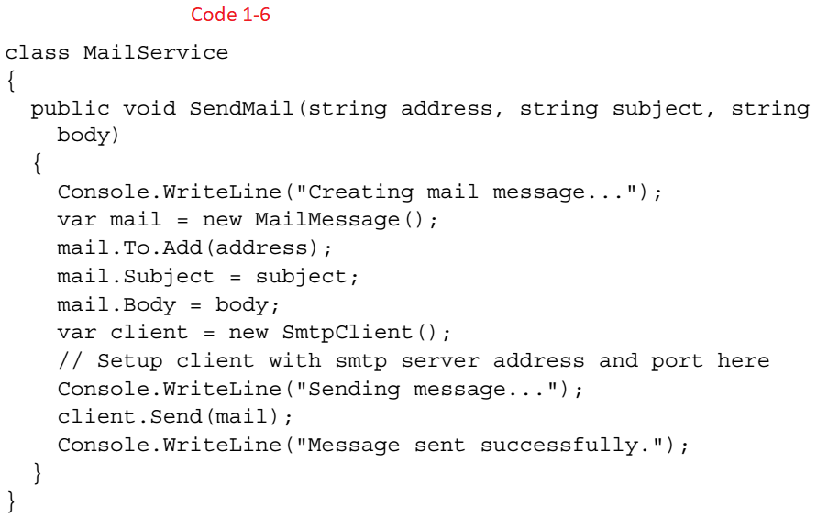
Code 1-5 || 1-6

Slide 20
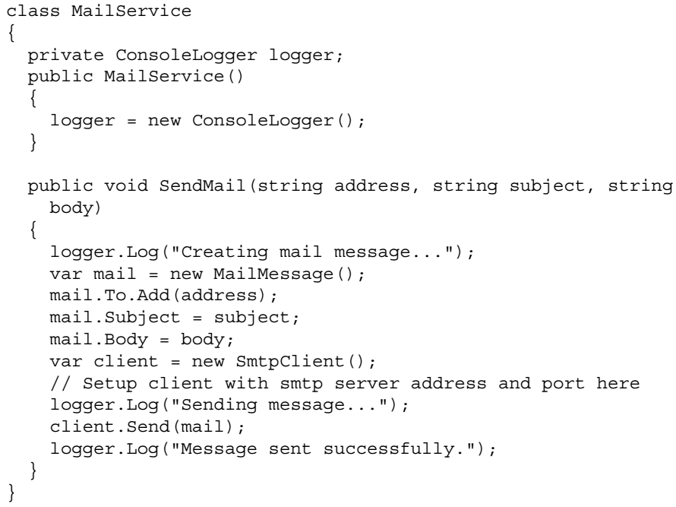
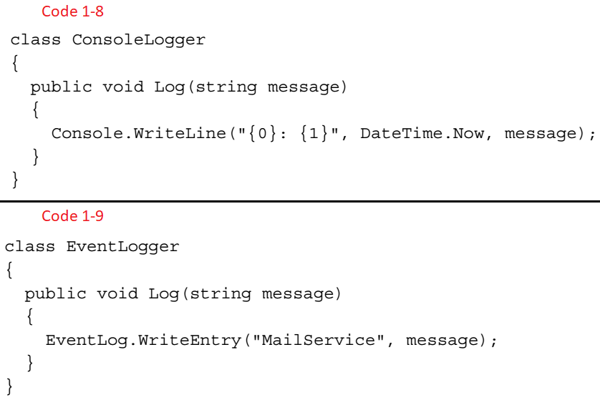
Code 1-7 || 1-8 || 1-9

Slide 21
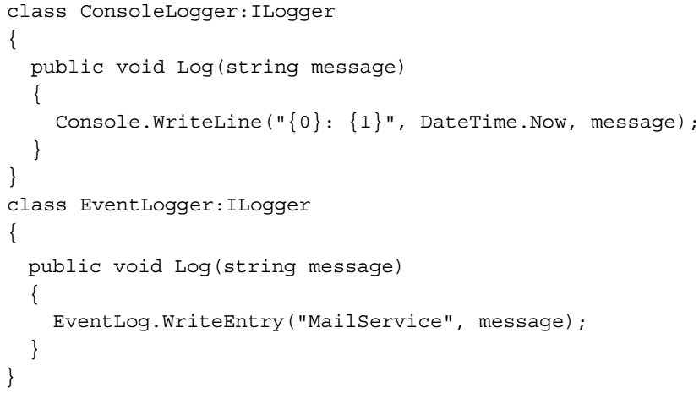
Code 1-10

Slide 22
DI Containers
A DI container is an injector object that injects the dependencies into a dependent object.
As we have seen in the previous example, we don't necessarily need a DI container in order to implement Dependency Injection.
However, in more complex scenarios, a DI container can save a lot of time and effort by automating most of the tasks that we had to do manually.
In real world applications, a single dependent class can have many dependencies, each of which have their own dependencies that forms a large graph of dependencies.
A DI container should resolve the dependencies, and this is where the decision of selecting a concrete class for the given abstraction should be made.
This decision is made by a mapping table, which is either based on a configuration file or is programmatically defined by the developer.
We can see an example for both here:
This one is an example of code-based configuration:

Slide 23
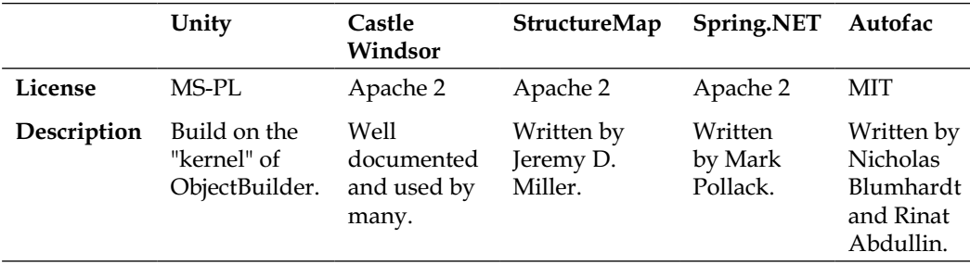
DI Containers |
We can also define conditional rules instead of just mapping a service to a concrete type.
We will discuss this feature in detail in Chapter 2, Getting Started with Ninject.
A container has the responsibility of dealing with the lifetime of the created objects.
It should know how long an object should be kept alive, when to dispose of it, in what condition to return the existing instance, and in what condition to create a new one.
DI Containers are also known as IoC Containers.
There are other DI Container besides Ninject. You can find a list of them in Scott Hanselman's blog (http://www.hanselman.com/blog/ ListOfNETDependencyInjectionContainersIOC.aspx).
Unity, Castle Windsor, StructureMap, Spring.NET, and Autofac are a few of them:

Slide 24
Why use Ninject?
Ninject is a lightweight Dependency Injection framework for .NET applications.
It helps you split your application into a collection of
loosely-coupled,
highly-cohesive pieces
and then glues them back together in a flexible manner.
By using Ninject to support your software's architecture, your code will become easier to write, reuse, test, and modify.
Instead of relying on reflection for invocation, Ninject takes advantage of lightweight code generation in the CLR (Common Language Runtime).
This can result in a dramatic (8-50x) improvement in performance in many situations.
Ninject includes many advanced features.
For example, Ninject was the first dependency injector to support contextual binding, in which a different concrete implementation of a service may be injected, depending on the context in which it is requested.

Slide 25
Why use Ninject? |
Ninject supports most major facilities offered by the competing frameworks (although, many such elements live in extensions: plugin modules that layer on facilities on top of the core).
You can have a look at the Ninject official wiki at https://github.com/ninject/ninject/wiki for a more detailed list of Ninject features which makes it one of the top DI containers.

Slide 26
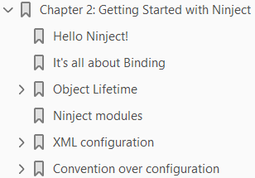
2
Getting Started with Ninject

Slide 27
Intro
This chapter teaches the user how to add Ninject to a practical project and use the basic features of this framework.
The chapter starts with an example demonstrating how to setup and use Ninject in a Hello World project.
Then, we will talk about how Ninject resolves dependencies and how it manages object lifetime.
Final sections of this chapter will cover
code-based configuration using Ninject modules
XML-based configuration using an XML file
By the end of this chapter, the user will be able to setup and use basic features of Ninject.
The topics covered in this chapter are:
Hello Ninject! It's all about Binding
Object Lifetime Ninject modules
XML configuration Convention over configuration

Slide 28
Hello Ninject!
Although DI is for complex projects, and applying it to a simple project looks like over-engineering, a Hello World project should usually be as simple as possible to show only how a framework works.
This project helps us understand how to setup Ninject and run it in the simplest way.
So, if you have already used Ninject and are familiar with this process, you can skip this section and continue reading the next one.

Slide 29
Step 1
The first step to setup Ninject is to download Ninject library.
You can do it either using NuGet or by downloading the binary file.
If you have NuGet package manager, create a new Console Application project in Visual Studio, and then simply search for Ninject in NuGet UI to install the package, as the following figure illustrates.
Alternatively, you can type install-package Ninject, and then press enter in the Packet Manager Console located at View | Other Windows menu.
Once the installation of Ninject package is finished, jump to step 5.
If you don't have NuGet package manager, go to the download page of Ninject official website (http://www.ninject.org/ download.html) and download the most recent version for your desired framework.
Considering Ninject is an open source project, you can even download the source codes from GitHub via the link provided on the download page.

Slide 30
Step 2
In Windows Vista and other newer versions of Windows, you need to unblock the downloaded archive prior to uncompressing it, in order to prevent further security issues at runtime.
Simply right-click on the downloaded file, open Properties, and from the General tab, click on the Unblock button.
Then, unzip the archive to your libraries directory (for example, D:\Libraries\Ninject).

Slide 31
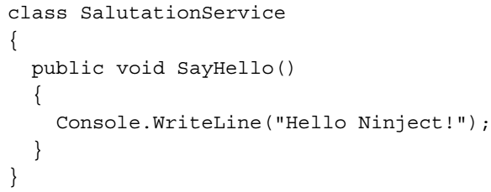
Step 3 || 4 || 5 || 6
Open Visual Studio and create a new Console Application project.
Add a reference to Ninject.dll in your library directory.
Add a new class to your project and call it SalutationService:
Add using Ninject to the using section of Program.cs.

Slide 32
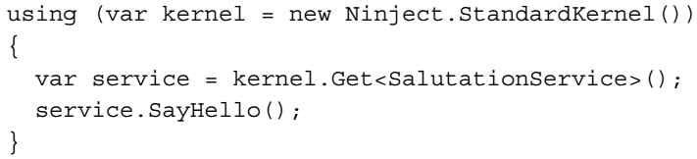
Step 7 || 8
Add the following lines to your Main method:
Run the application.
That is how Ninject works in the simplest way.
We didn't even need to add any configuration or annotation.
Although we didn't have anything to inject in the previous example, Ninject did its main job, which was resolving a type (SalutationService).

Slide 33
Ninject working Principle
Let's have a look at the Main method to see what was happening there.
In the first line, we created a kernel object by instantiating StandardKernel.
Kernel is always the start point of creating our dependency graph.
In this simple example, the graph only consists of one type, which is SalutationService.
As we see, we didn't call the constructor of SalutationService in neither of the Main method lines.
Instead, we asked our container (kernel) to do it for us.
We gave our required type to the Get method, and it returned an instance of the given type.
In other words, the Get method was provided with the root type (SalutationService) of our dependency graph and returned the graph object.
Now that we know how to setup Ninject, let's move ahead to a more complex example to see how Ninject helps us to implement DI better.

Slide 34
It's all about Binding
In Chapter 1, Understanding Dependency Injection, we implemented DI manually in the MailService class.
You remember that we ignored the configuration of SmtpClient to simplify the project.
Now, we are going to add the configuration of SmtpClient and implement DI using Ninject.
Let's start by creating the MailConfig class – Code 2-1.
Now, we can update the MailService class and incorporate MailServiceConfig: Code 2-2.
The class consists of two methods and one constructor.
The SendMail method is not changed so much, except that it is no more instantiating SmtpClient and is using the new introduced client field.
We have added a new method called InitializeClient, which instantiates and initializes the client field using the given MailServerConfig object.
The constructor has been added another parameter, which accepts an object of MailServerConfig, which contains some settings obtained from the application configuration file.
The Figure 2-1 shows the dependency graph of this application.
Now, let's see how Ninject is going to resolve the dependencies and create the graph object.

Slide 35
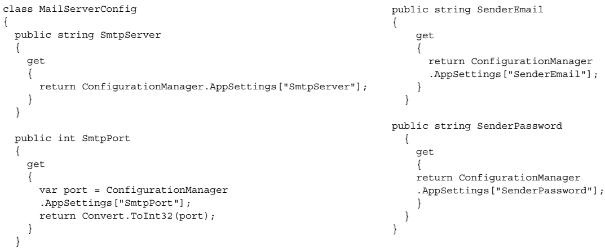
Code 2-1

Slide 36
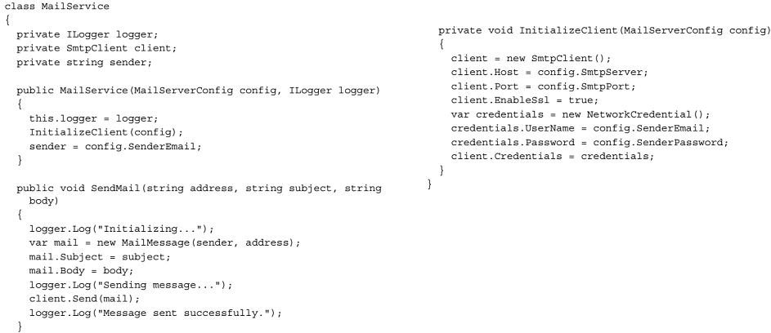
Code 2-2

Slide 37
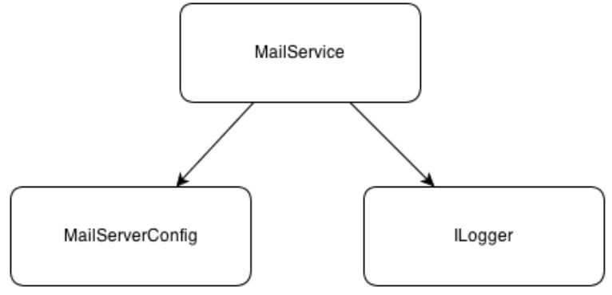
Figure 2-1

Slide 38

Ninject in action
Considering the last example, we need a kernel object and give it the starting node of our graph, so that it returns the entire graph as the following code shows:
Ninject starts by resolving the MailService type.
It finds the type and realizes that in order to instantiate it, first it should create an instance of MailServerConfig and ILogger.
That is because Ninject automatically creates arguments that should be passed to the constructor of the type being instantiated.
It injects these arguments to the constructor parameters without us having to instruct it to do so.
Creating an instance of MailServerConfig is as easy as calling its only constructor, but what about ILogger? ILogger is an interface, and it is not possible to create an instance of an interface itself.
Also, it may have multiple implementations.
So, how is Ninject supposed to know which implementation of ILogger to use?

Slide 39
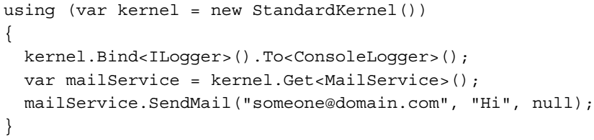
Ninject in action |
Ninject uses its Binding system to decide what implementation to use for a given type.
A binding is an instruction which maps one type (usually an abstract type or an interface) to a concrete type that matches such a given type.
This process is also called Service Registration.
The following code instructs Ninject how to resolve ILogger:
It means that Ninject should always use the ConsoleLogger type as an implementation type for the ILogger type.
The final Main method's body looks like this:

Slide 40
NOTE
If multiple services should be bound to a single component, use this syntax:

Slide 41
Object Lifetime
One of the responsibilities of a DI container is to manage the lifetime of objects that it creates.
It should decide when to create a new instance of the given type and when to use an existing instance.
It should also take care of disposing of objects when they are not used anymore.
Ninject has a strong support for managing Object Lifetime in different situations.
Whenever we define a binding, we can declare the scope of the object instance being created.
Within that scope, the object instance will be reused and exist exactly once for each binding.
Note that an object is not allowed to have a dependency on an object with shorter lifetime.

Slide 42
Transient scope
In Transient scope, the object lifetime is not managed by Ninject.
Whenever we request an instance of a type, a new one will be created.
Ninject doesn't take care of keeping the created instance or disposing of it in this scope.
This is the default object scope in Ninject.
If no scope is explicitly specified, they are transient-scoped. In the previous code, both ConsoleLogger and MailService were treated in the Transient scope because the object scope was not specified.

Slide 43
Singleton scope
In the previous example, the ILogger interface is bound to the ConsoleLogger class, which means whenever Ninject encounters ILogger, it should create a new instance of ConsoleLogger.
But we don't really need multiple instances of ConsoleLogger in all of the classes that need to log to console. Looks like it is a good idea to make ConsoleLogger singleton.
There are two approaches to achieve this.
The first one is using one of the Singleton patterns: Code 2-3.
And instructing the binding to always use the provided instance rather than every time creating a new instance of ConsoleLogger.
We can achieve this by using the ToConstant method:
However, if we make a singleton type like this, we will draw some limitations to our class. For example, we won't be able to unit test, it because it doesn't have a default constructor.

Slide 44
Singleton scope |
Using lifetime management of Ninject, we will be able to have singleton objects without having to make their type singleton.
All we need to do is to instruct Ninject to treat the given type as singleton:
Now, what if we decide to change the scope of MailServerConfig to singleton as well? There is no binding definition for this type because Ninject already knows how to resolve it.
Such classes are actually bound to themselves. Although Ninject doesn't require us to register such types, if we need to change their scope, we can explicitly define their binding in order to set their lifetime scope:

Slide 45
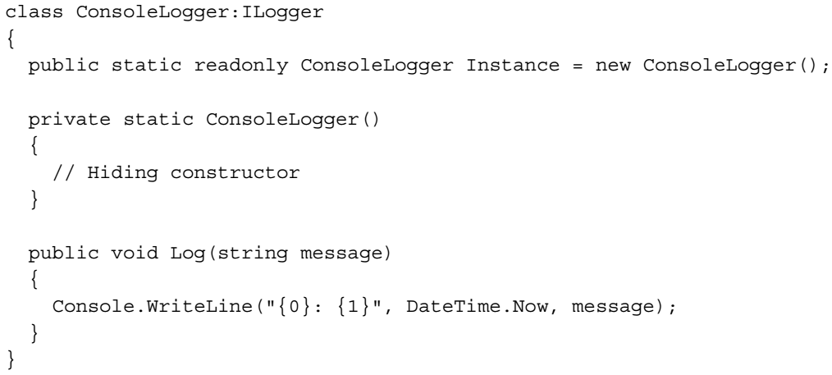
Code 2-3

Slide 46
Thread scope
If we define a binding in Thread scope, only one instance of the given type will be created per thread.
The object lifetime is as long as the lifetime of the underlying Thread object.
The Code 2-4 asserts equality of instances created by Ninject in the same thread.
In the previous example, we instructed Ninject to bind the type object to itself and create new instances of object per thread.
Then, we asked Ninject to return two instances of type object in the same thread and tested their equality.
The test succeeded.
The Code 2-5 demonstrates inequality of the instances created from the same type but in different threads.
This time we got the second instance in another thread.
Ninject detects that the calling thread is changed, and this is the first time that an instance of object is being requested in this new thread.
So, it creates a new instance rather than returning the existing one.
Finally, we asserted inequality of the created instances.

Slide 47
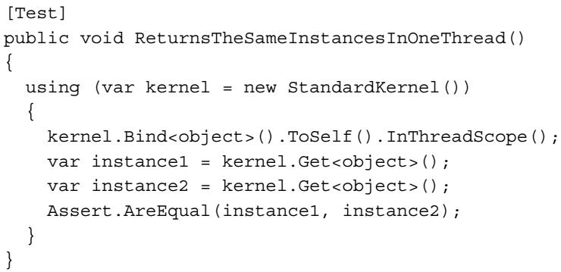
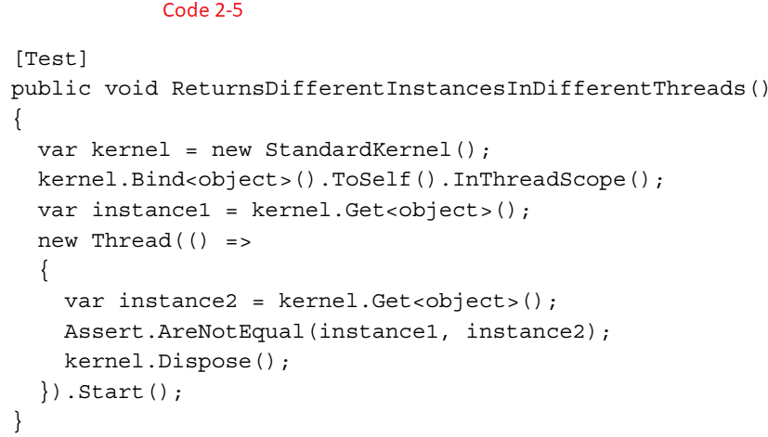
Code 2-4 || 2-5

Slide 48
Request scope
Request scope is useful in web applications when we need to get a single instance of a type from Ninject as long as we are handling the same request.
Once the request is processed and a new request arrives, Ninject creates a new instance of the type and keeps it until the end of the request processing.
Note that Request scope behaves like Transient scope outside of a web request (for example, during startup) or in non-web applications.
The following code shows how to change the scope of the MailService type, so that we get a new instance only for new web requests, and keep the existing instance during the current request:
The InRequestScope method is not available unless we add a reference to the Ninject.Web.Common library, which makes sense only in web applications.
Chapter 4, Ninject in Action, will discuss web applications in detail.

Slide 49
Custom scope

Slide 50
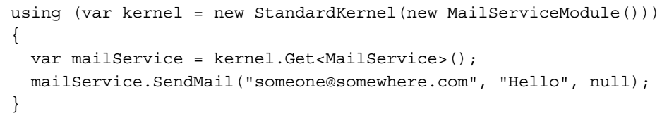
Ninject modules
As our application grows, the list of service registrations gets longer, and it would be difficult to manage this list.
Ninject modules are a good way to segregate our type bindings into distinct groups of bindings, which can be easily organized into separate files.
Minimum requirement for a class to be accepted as a Ninject module is to implement the INinjectModule interface.
Implementing this interface requires us to implement three methods and two properties each time we need to create a module.
It is a good idea to implement this interface as an abstract class once, and extend it whenever we need to create a Ninject module.
The good news is that Ninject has already implemented this abstract class, which is named NinjectModule.
Here is how to register our MailService classes in a module: Code 2-8.
After declaring our modules, we need to load them into kernel so that Ninject can use them to resolve the registered types.
Put this code into the Main method:

Slide 51
Ninject modules |
The following code shows how to load multiple modules in a single Ninject kernel:
We can also load all of the Ninject modules defined in an application at the same time using the following code:
In this case, Ninject looks in all assemblies for the public classes which have implemented the INinjectModule interface to load type registrations.
The next example will show how to load modules dynamically.

Slide 52
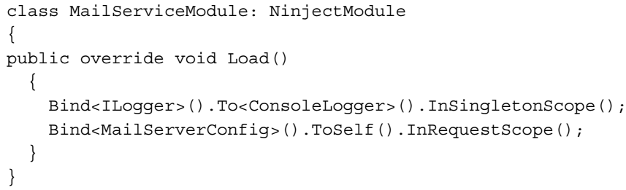
Code 2-8

Slide 53
XML configuration
Ninject supports both
code-based
XML configuration
An XML module is like a code module that consists of a list of type registrations via Ninject binding.
All bindings can be defined in a single XML document or segregated into multiple documents.
The only advantage of using XML modules over code modules is that once we have composed such a document, we can still change our type registrations without having to recompile any part of the application.
However, XML modules are not as powerful as code modules; so it is recommended to use code modules unless we need this feature.
Even in this case, we can only include those bindings for which we need to change the configuration at runtime in our XML module and keep other bindings in code modules.

Slide 54
How to use XML configuration

Slide 55
Convention over configuration

Slide 56
Selecting the assemblies

Slide 57
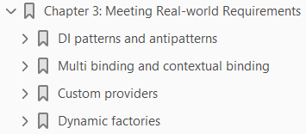
3
Meeting Real-world Requirements

Slide 58
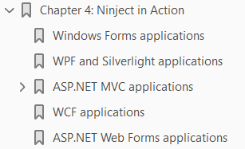
4
Ninject in Action

Slide 59
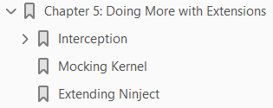
5
Doing more with Extensions

Slide 60
Ninject Version History

Slide 61
Ninject Version History
Version | Release Date
2.0.1 | Jan 2011
3.0.1 | May 2012
3.2.0 | Mar 2014
3.3.0 | Sep 2017

